Slide 1

Install & Configure SpiderFoot 4.0.0 on Kali Linux.

Slide 2
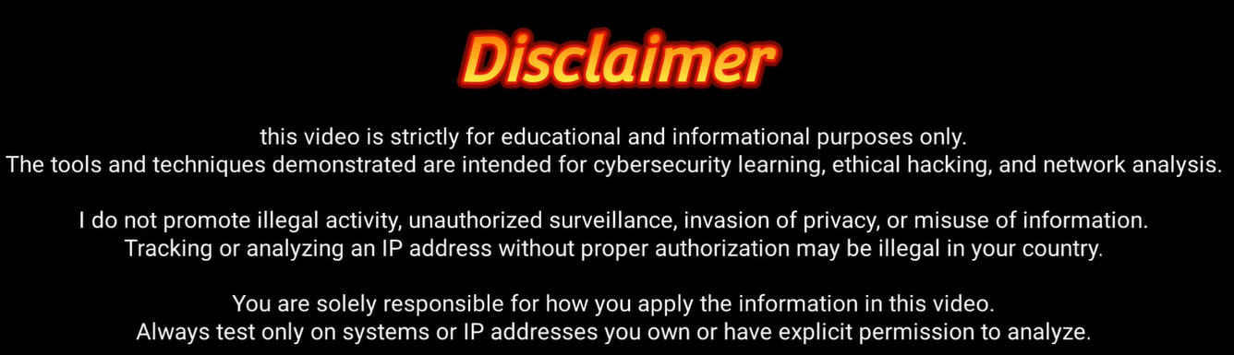

Slide 3
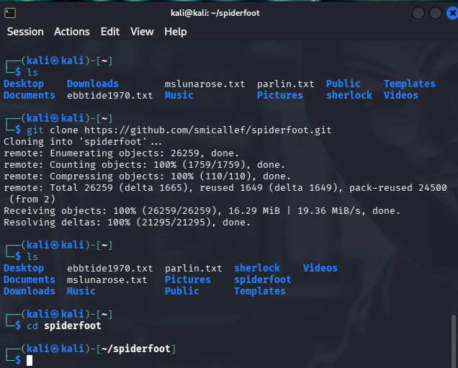
Commands to install SpiderFoot 4.0.0: 1. sudo apt install spiderfoot 2. git clone https://github.com/smicallef/spiderfoot.git 3. ls 4. cd spiderfoot

Slide 4
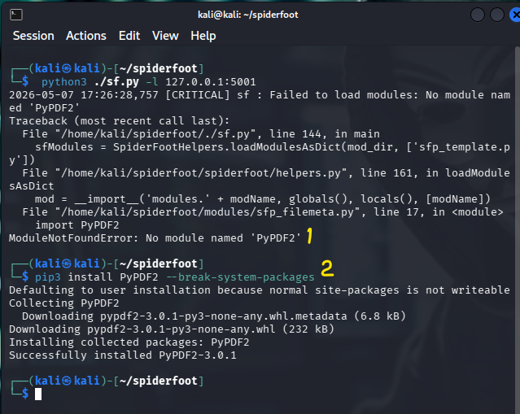
No module named PyDDF2 found, so PyPDF2 had to be installed. Use the command pip3 install secure==0.3.0 --break-system-packages to correct this.

Slide 5
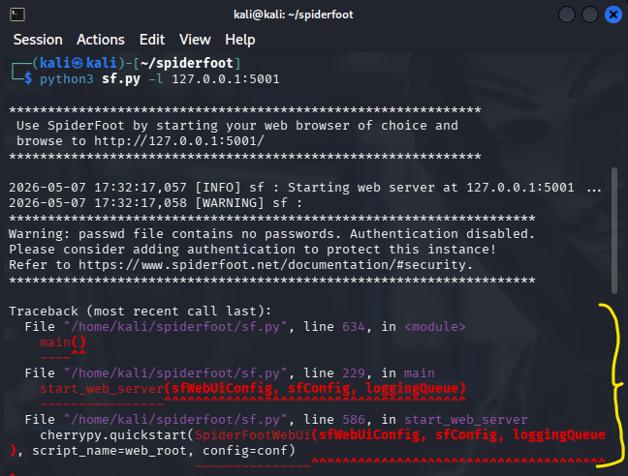
After running python3 sf.py –l 127.0.0.1:5001, the following error appeared:

Slide 6
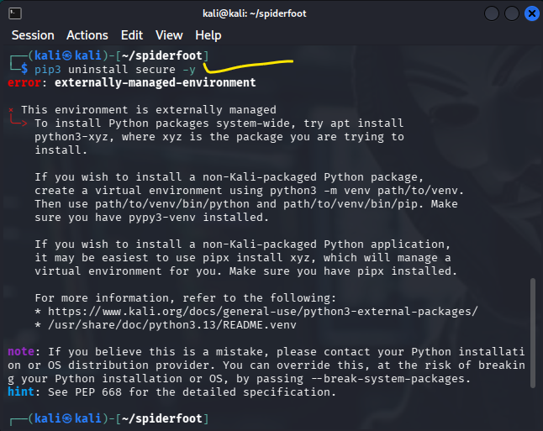
That error is caused by a newer incompatible Python package version. SpiderFoot’s secure package changed and broke compatibility. Fix it by installing the older working version. Run: pip3 uninstall secure -y

Slide 7
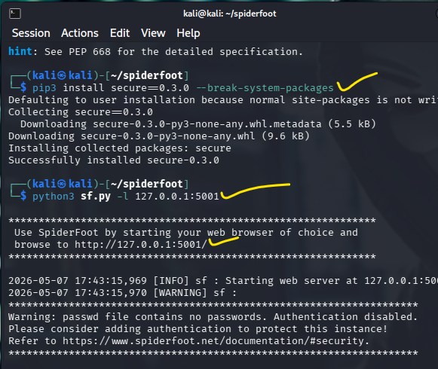
Now start SpiderFoot again: python3 sf.py -l 127.0.0.1:5001 You should finally see something like: Starting web server at http://127.0.0.1:5001

Slide 8
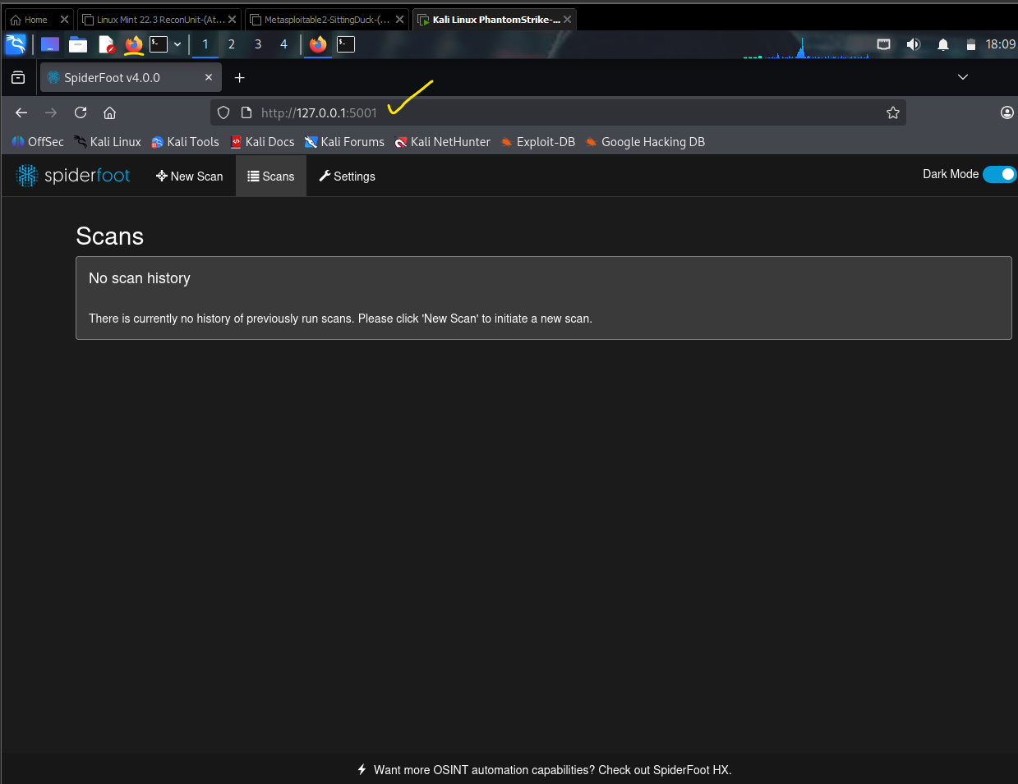
In the Kali GUI: 1.Open Firefox from the menu/taskbar. 2.Click the address bar at the top. 3. Type: http://127.0.0.1:5001 4. Press Enter. That should open the SpiderFoot web interface running locally on your Kali VM.

Slide 9
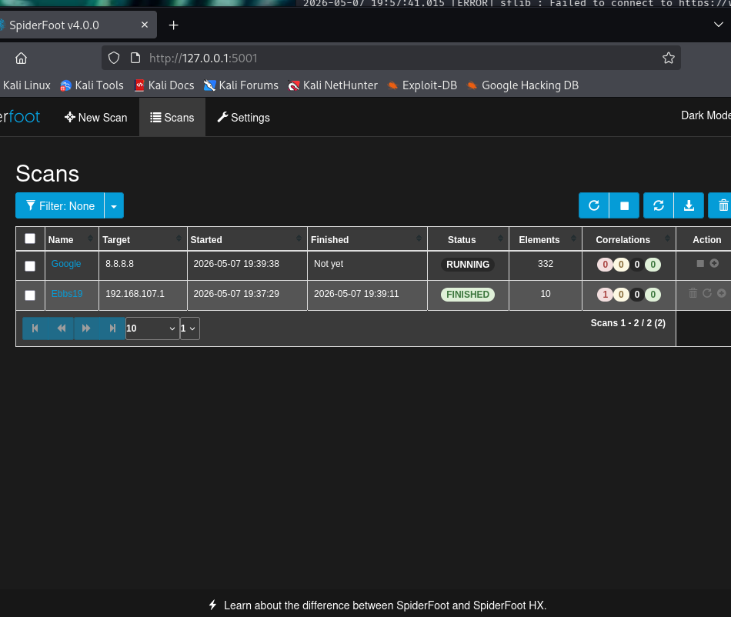
Proof of Concept – Sample Scans in SpiderFoot 4.0.0.0!

Slide 10
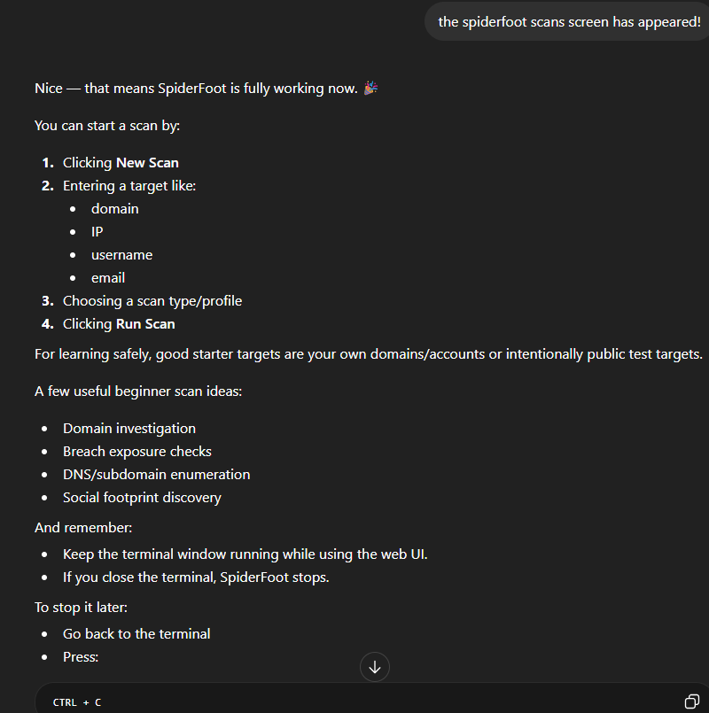
💡Helpful Hints and Tips!

